Slide 1



Slide 2


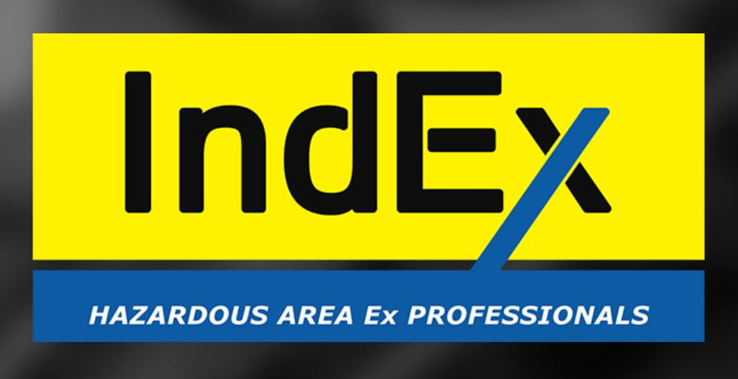

IndEx Hazardous Area Ex Professionals
Michael MARRINGTON
Hazardous Area Classification (HAC) –
The Standardized Method…
HAZOP, CAPEX, OPEX

Slide 3

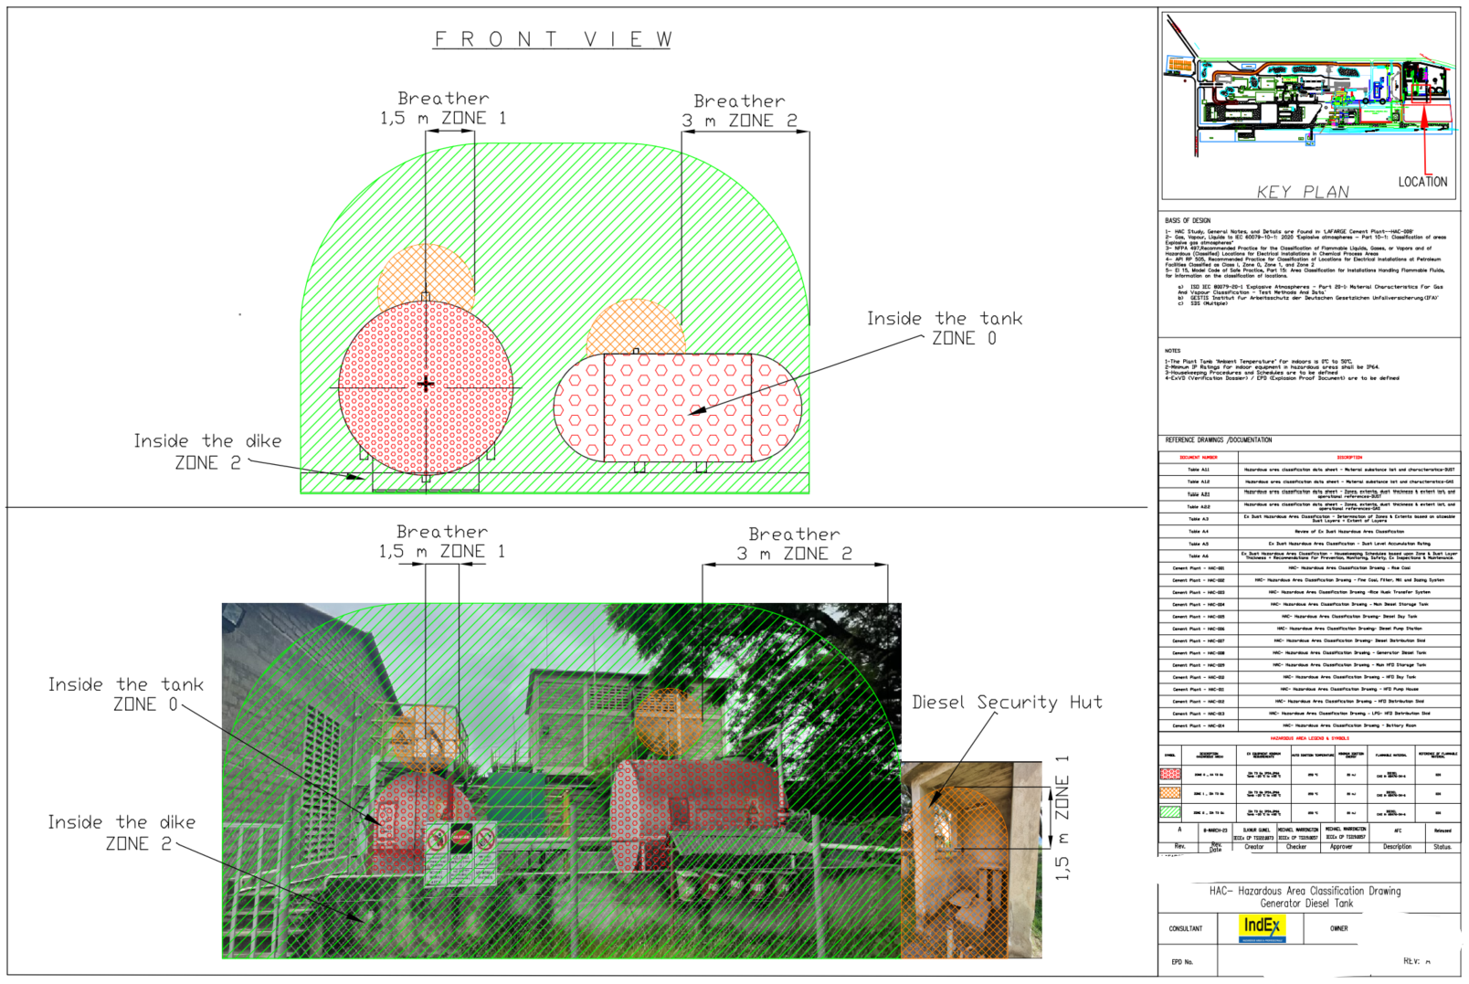
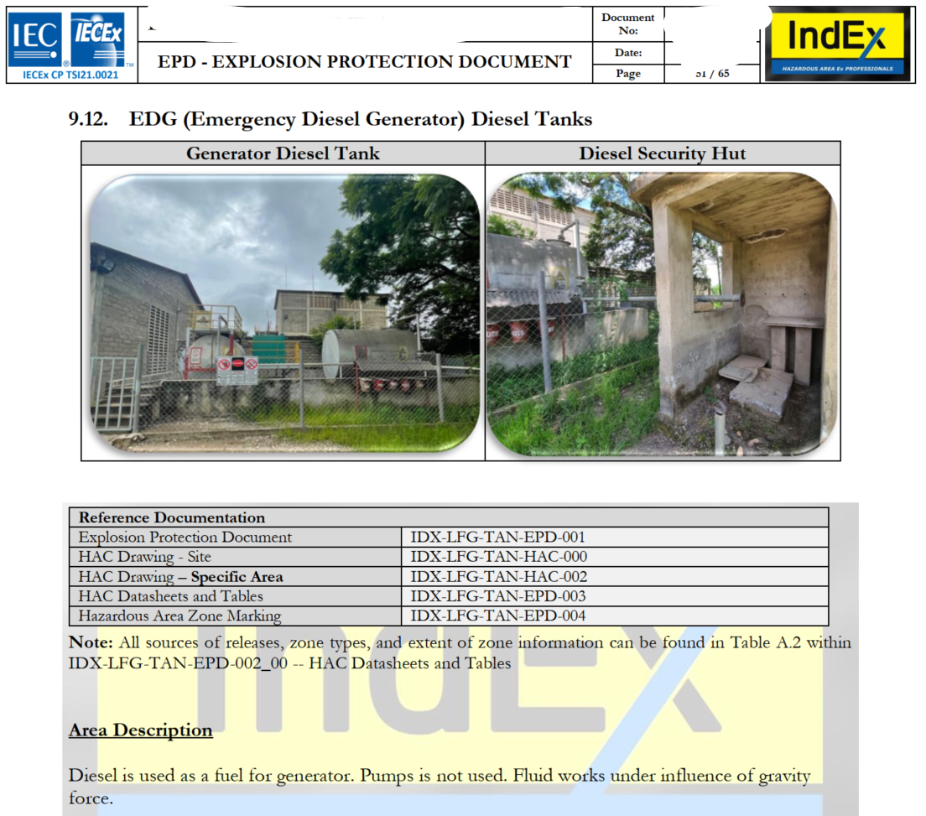
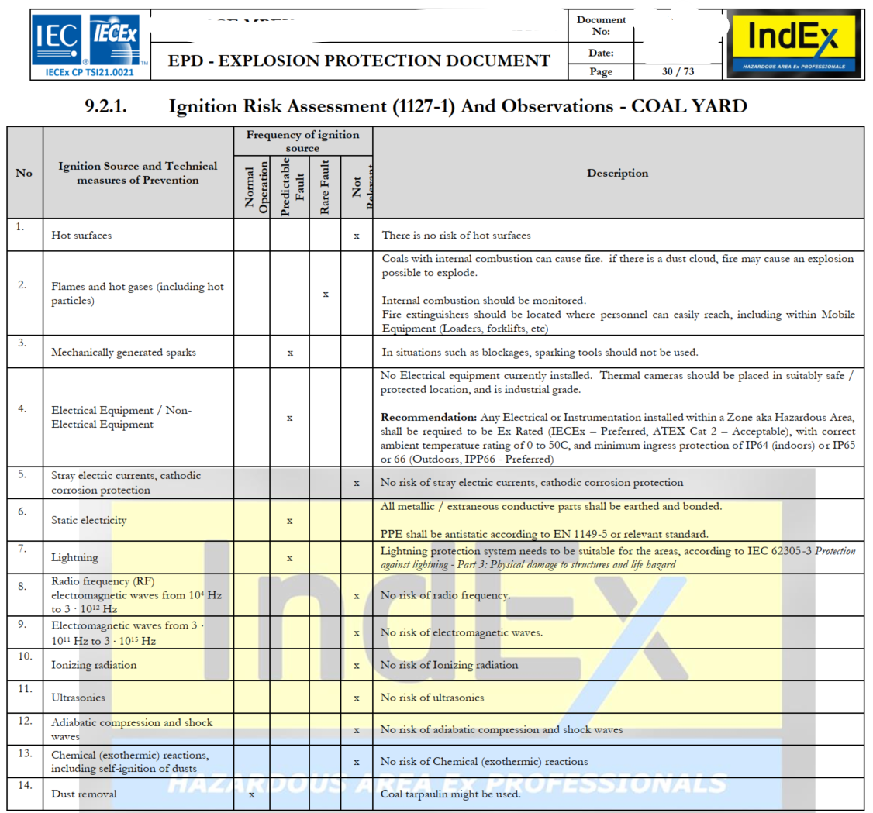
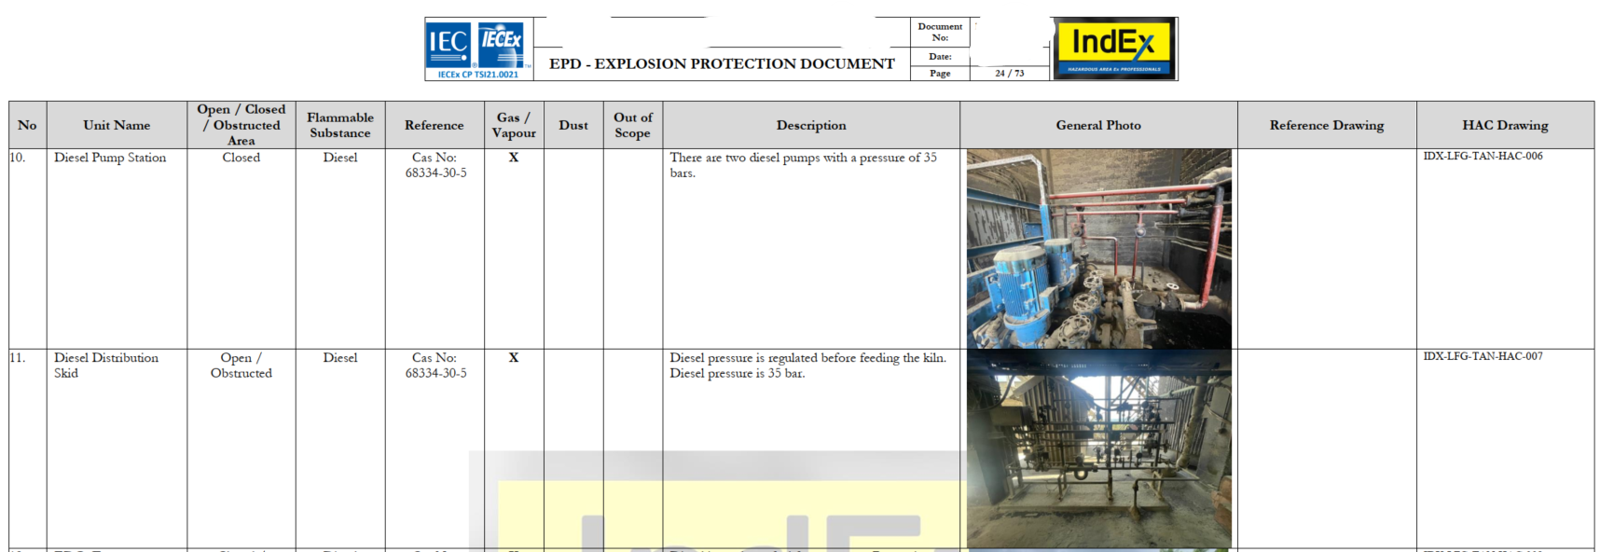
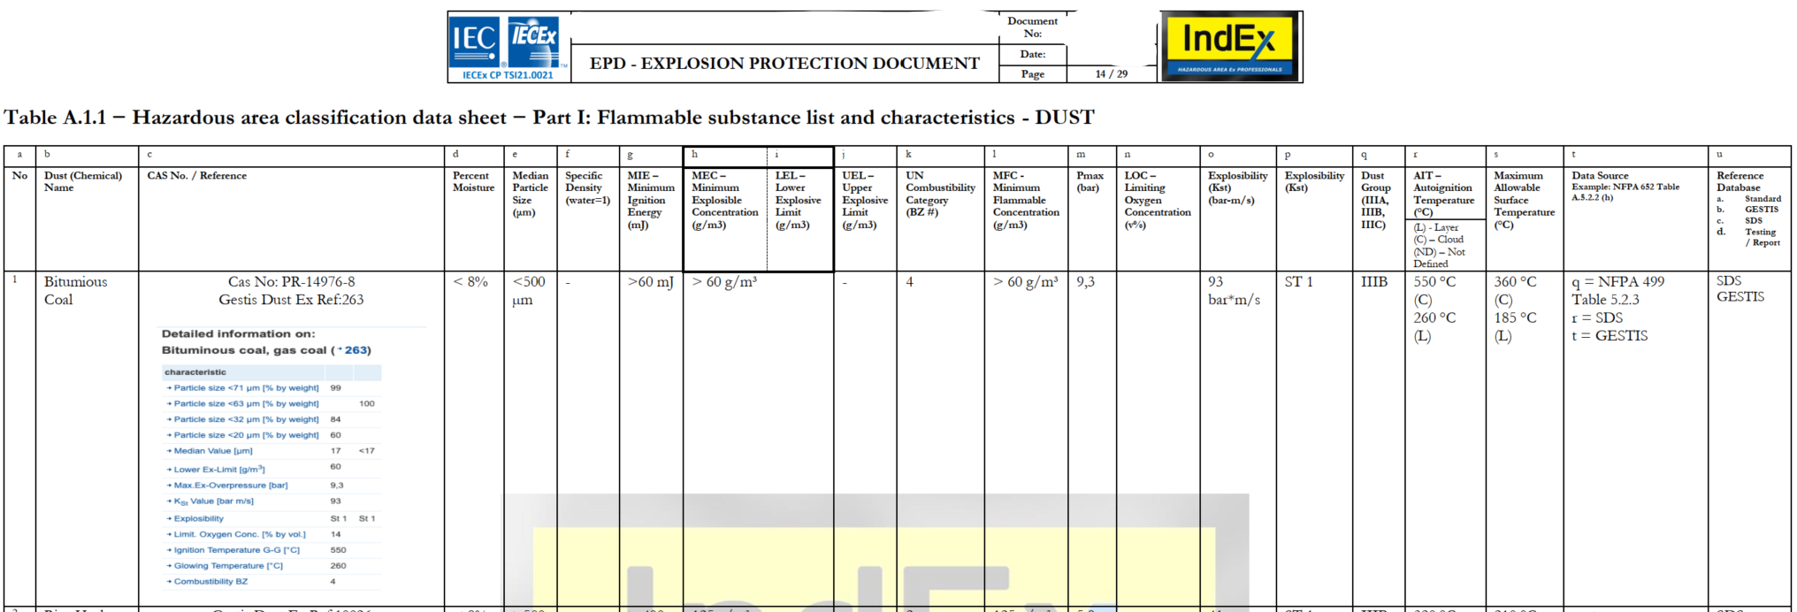
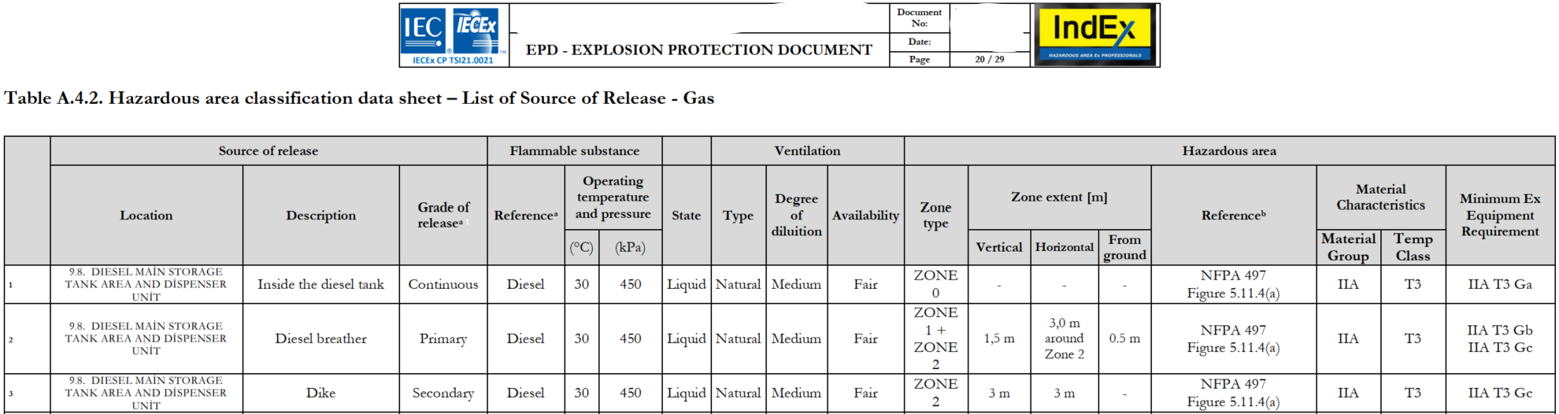
Hazardous Area Classification (HAC) – The Standardized Method

Slide 4

Introduction – IndEx & Michael Marrington
IndEx – Hazardous Area Ex Professionals
2020 – Partnership with ExTEC EXTEC Mühendislik Danışmanlık Ltd. Şti.
Created in 2016 by Arpad Veress
  IEC TC31 Committee Member (Global)
  CENLEC TC31 Committee Member (HU – Europe)
  IECEx 05 Auditor
  Government Consultant in the implementation of Ex Regulations (ECASEx – UAE, SASOEx – KSA, etc)
Ex Trainers (ATEX, IECEx, AEx, EEHA, etc) to IEC 60079 Series, ISO IEC 80079 Series, and other standards.
Qualifications & Competencies: Electrical, Instrumentation, and Mechanical Engineers and Technicians. IECEx CoPC, CompEx, EEHA, ISO 9001, ExAM ATEX, etc
Services
  Hazardous Area Classification + Ignition Hazard Assessment: Creation, Review, Verification, Validation
  Consultation: Equipment Manufacturers, EPC, End Users
  Ex Training and Certification
  Ex Inspections: Audit, FAT, SAT, Initial, Sample

Slide 5

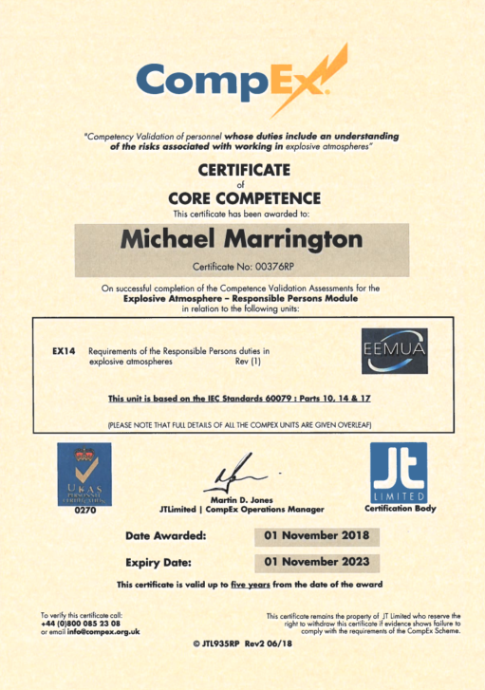
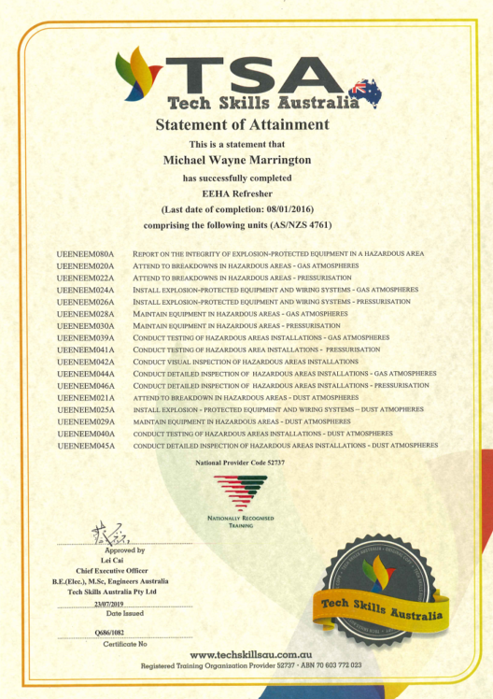
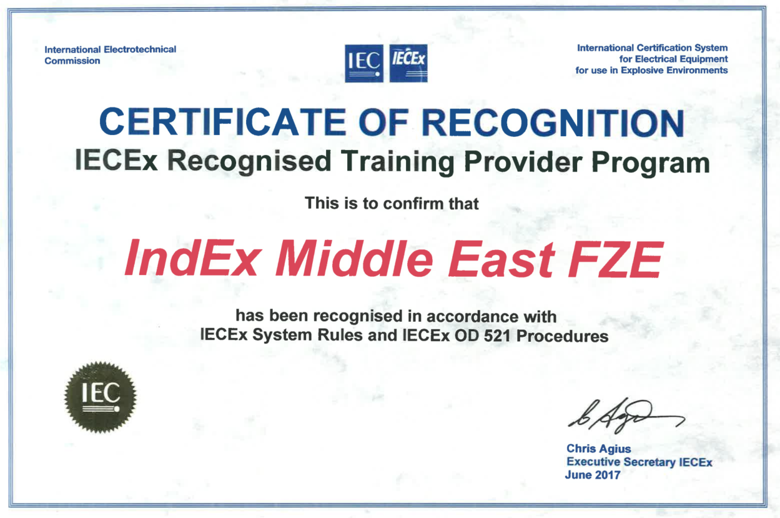
Introduction – IndEx & Michael Marrington
IndEx – Hazardous Area Ex Professionals

Slide 6




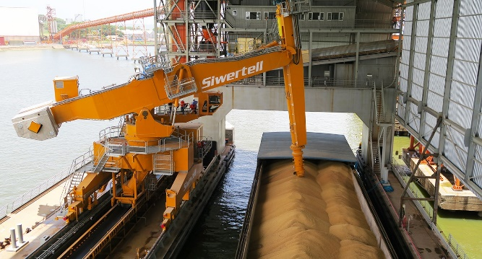

Slide 7

HAC – Why?
IEC 60079-10-1: Explosive atmospheres –
Part 10-1: Classification of areas – Explosive gas atmospheres
‘This part of IEC 60079 is concerned with the classification of areas where flammable gas or vapour hazards may arise and may then be used as a basis to support the proper design, construction, operation and maintenance of equipment for use in hazardous areas.’
MUST and SHALL be used

Slide 8
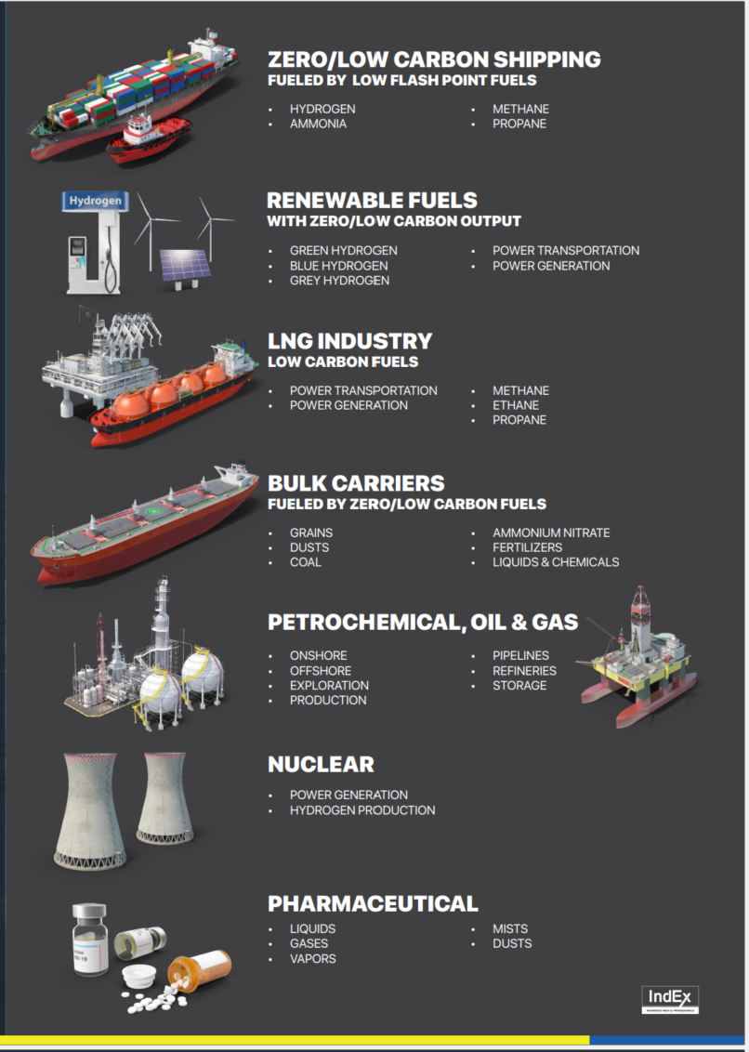
HAC – Why?
Note 1: Flammable Materials include: gases, vapours, liquids, dusts, fibres, flyings, and hybrids (Gas+Dust)
Note 2: Hazardous Areas are not just limited to traditional industries that we know (Oil & Gas), but also the growing Renewables, Low Flash Point Fuels, Mining, Machining, Pharmaceuticals, etc

Slide 9
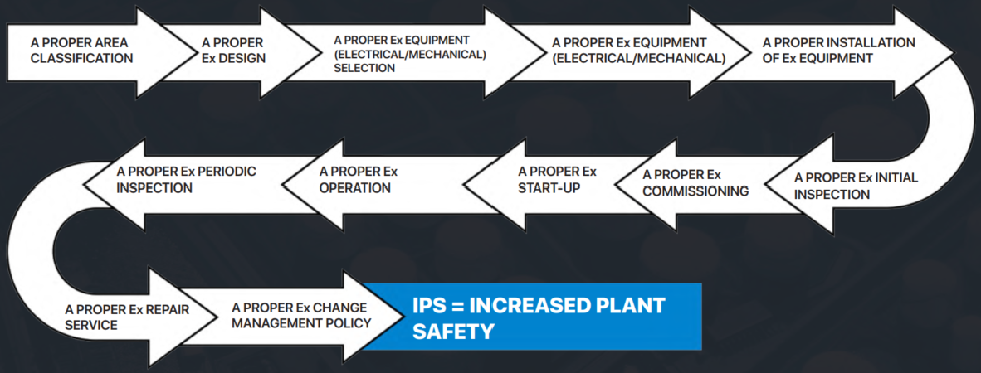

HAC – Why?
HAZOP

Slide 10
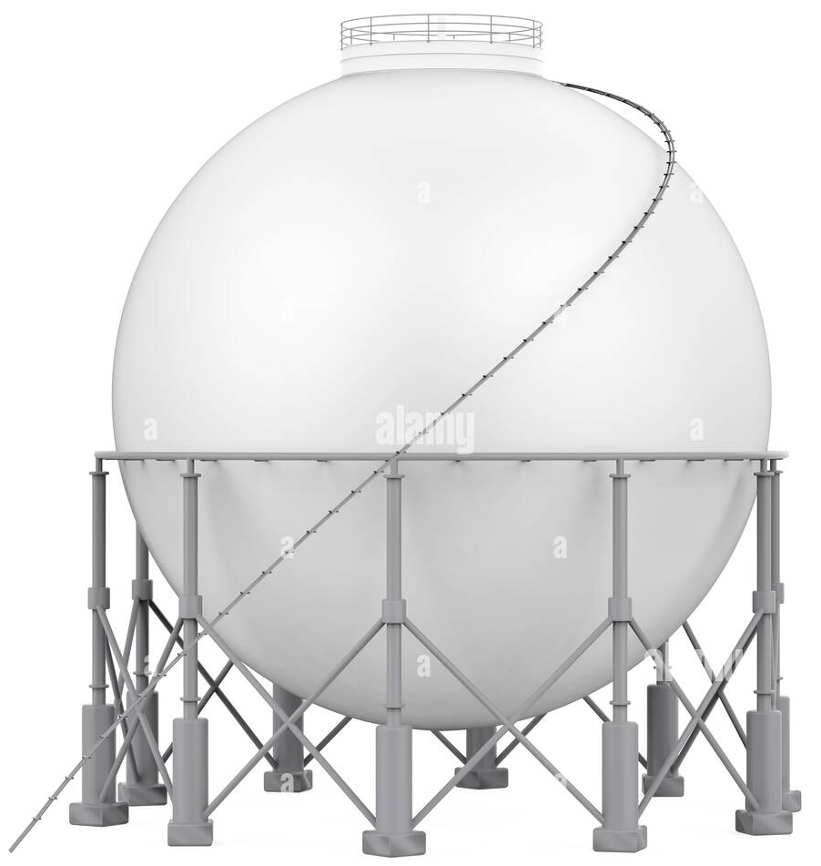




HAZOP vs HAC
Example: LPG Sphere
Objectives of HAZOP
The more general objective of a HAZOP is to improve the operations carried out on a system, reducing its associated risks, thus improving its efficiency
Objectives of Hazardous Area Classification + Ignition Hazard Assessment
In areas where dangerous quantities and concentrations of flammable materials may arise, protective measures need to be applied in order to reduce the risk of explosions. IEC 60079-10-1, IEC 60079-10-2, EN 1127-1, sets out the essential criteria against which the ignition hazards can be assessed and gives guidance on the design and control parameters which can be used in order to reduce such hazards.

Slide 11
HAZOP vs HAC
Example: LPG Sphere
HAZOP Inputs
To install a Dike / Bunding or NOT. How shall it be done?
Cement (solid surface) or Rocks (loose ground)
Hazardous Area Classification + Ignition Hazard Assessment Inputs
What will be the resultant Zones Type
What will be the Extents (Meters) of each zone
What impact will this have on Equipment?
  13 Sources of Ignition
  Ex or Non-Ex
  Design
  Selection
  Installation
  Maintenance
  Operation

Slide 12
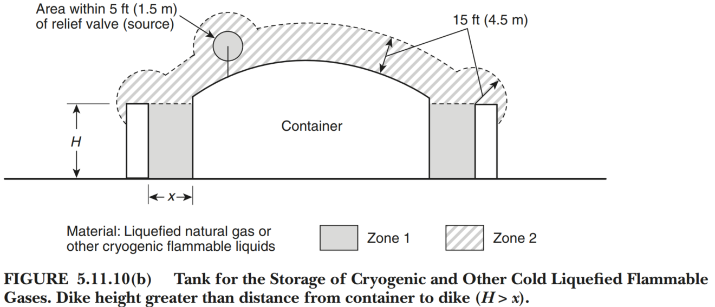
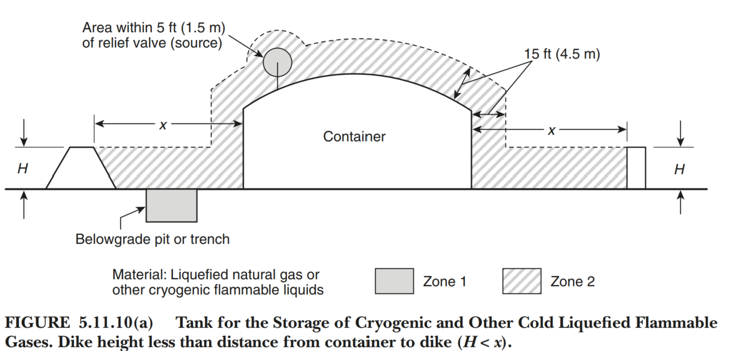
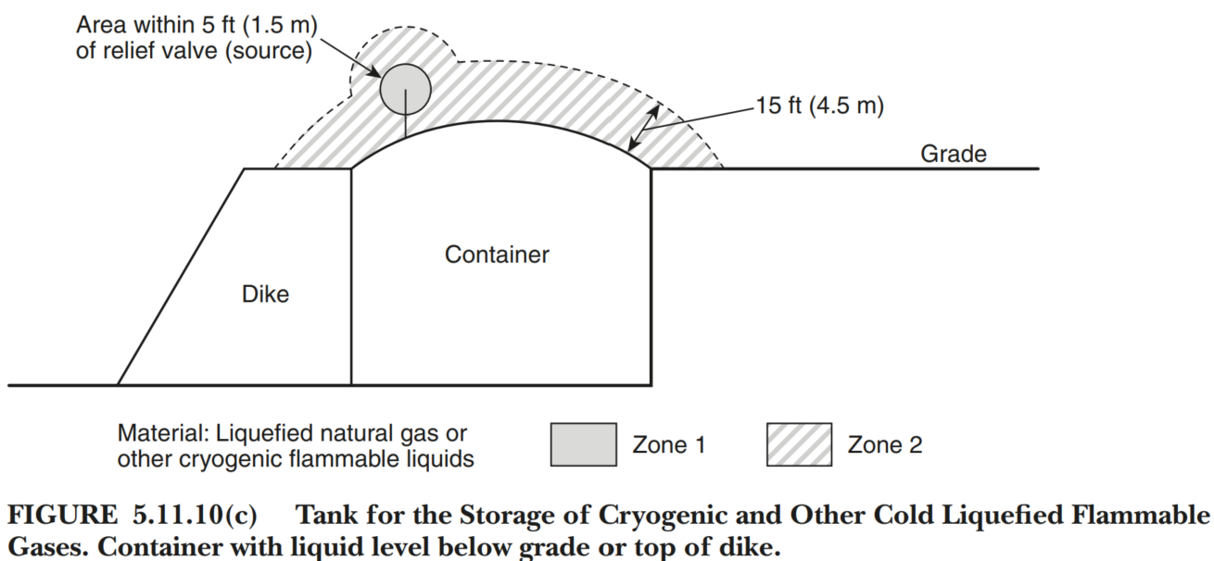





HAZOP vs HAC
Example: LPG Sphere
NOTE:
HAZOP decisions DIRECTLY impact Hazardous Area Classification
HAC Member MUST be a HAZOP team member, to provide feedback with impacts on Classification, Design, Selection, Installation, Maintenance, and Operations …
… over the COMPLETE Design Life of the Facility
Typical Example:
>25 YEARS
KEY POINT
This person requires…
  Engineering Experience
  Practical (In-Field) Experience
  Construction (EPC) and Operations Experience (User)

Slide 13
HAC: Competence and Competency of those performing
Competence (Skills, knowledge, and experience) +
Competency (Behavior, goals, desired outcomes)
KEY POINTS
This person or Company requires…
  Engineering Experience (Process, Electrical, Mechanical, Ventilation)
  Practical (In-Field) Experience to address:
    Avoiding incorrect assumption, negative impacts, lack of transparency, etc
    CAPEX impacts … (Design, Procurement, Selection, Installation, Ex Initial Inspection, Commissioning)
    OPEX impacts … (Operations, Maintenance, Inspections, Repairs, etc)
    Protect CAPEX Stakeholders Interests (EPC, EPCM, Community, Government, Client aka Owner)
    Protect OPEX Stakeholders Interests (Owner, Operator, Community, Government, Shareholders)
  Construction (EPC) Experience
    The CAPEX impacts
    Design, Selection, Installation, Initial Ex Inspection, and Commissioning impacts
    Protect Stakeholders Interests (EPC, EPCM, Community, Government, Client aka Owner)
  Operations Experience (User)
    Refer to Practical (In-Field) Experience

Slide 14
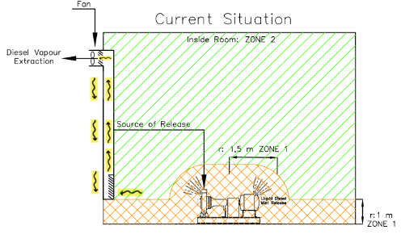
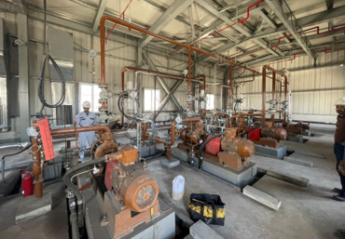
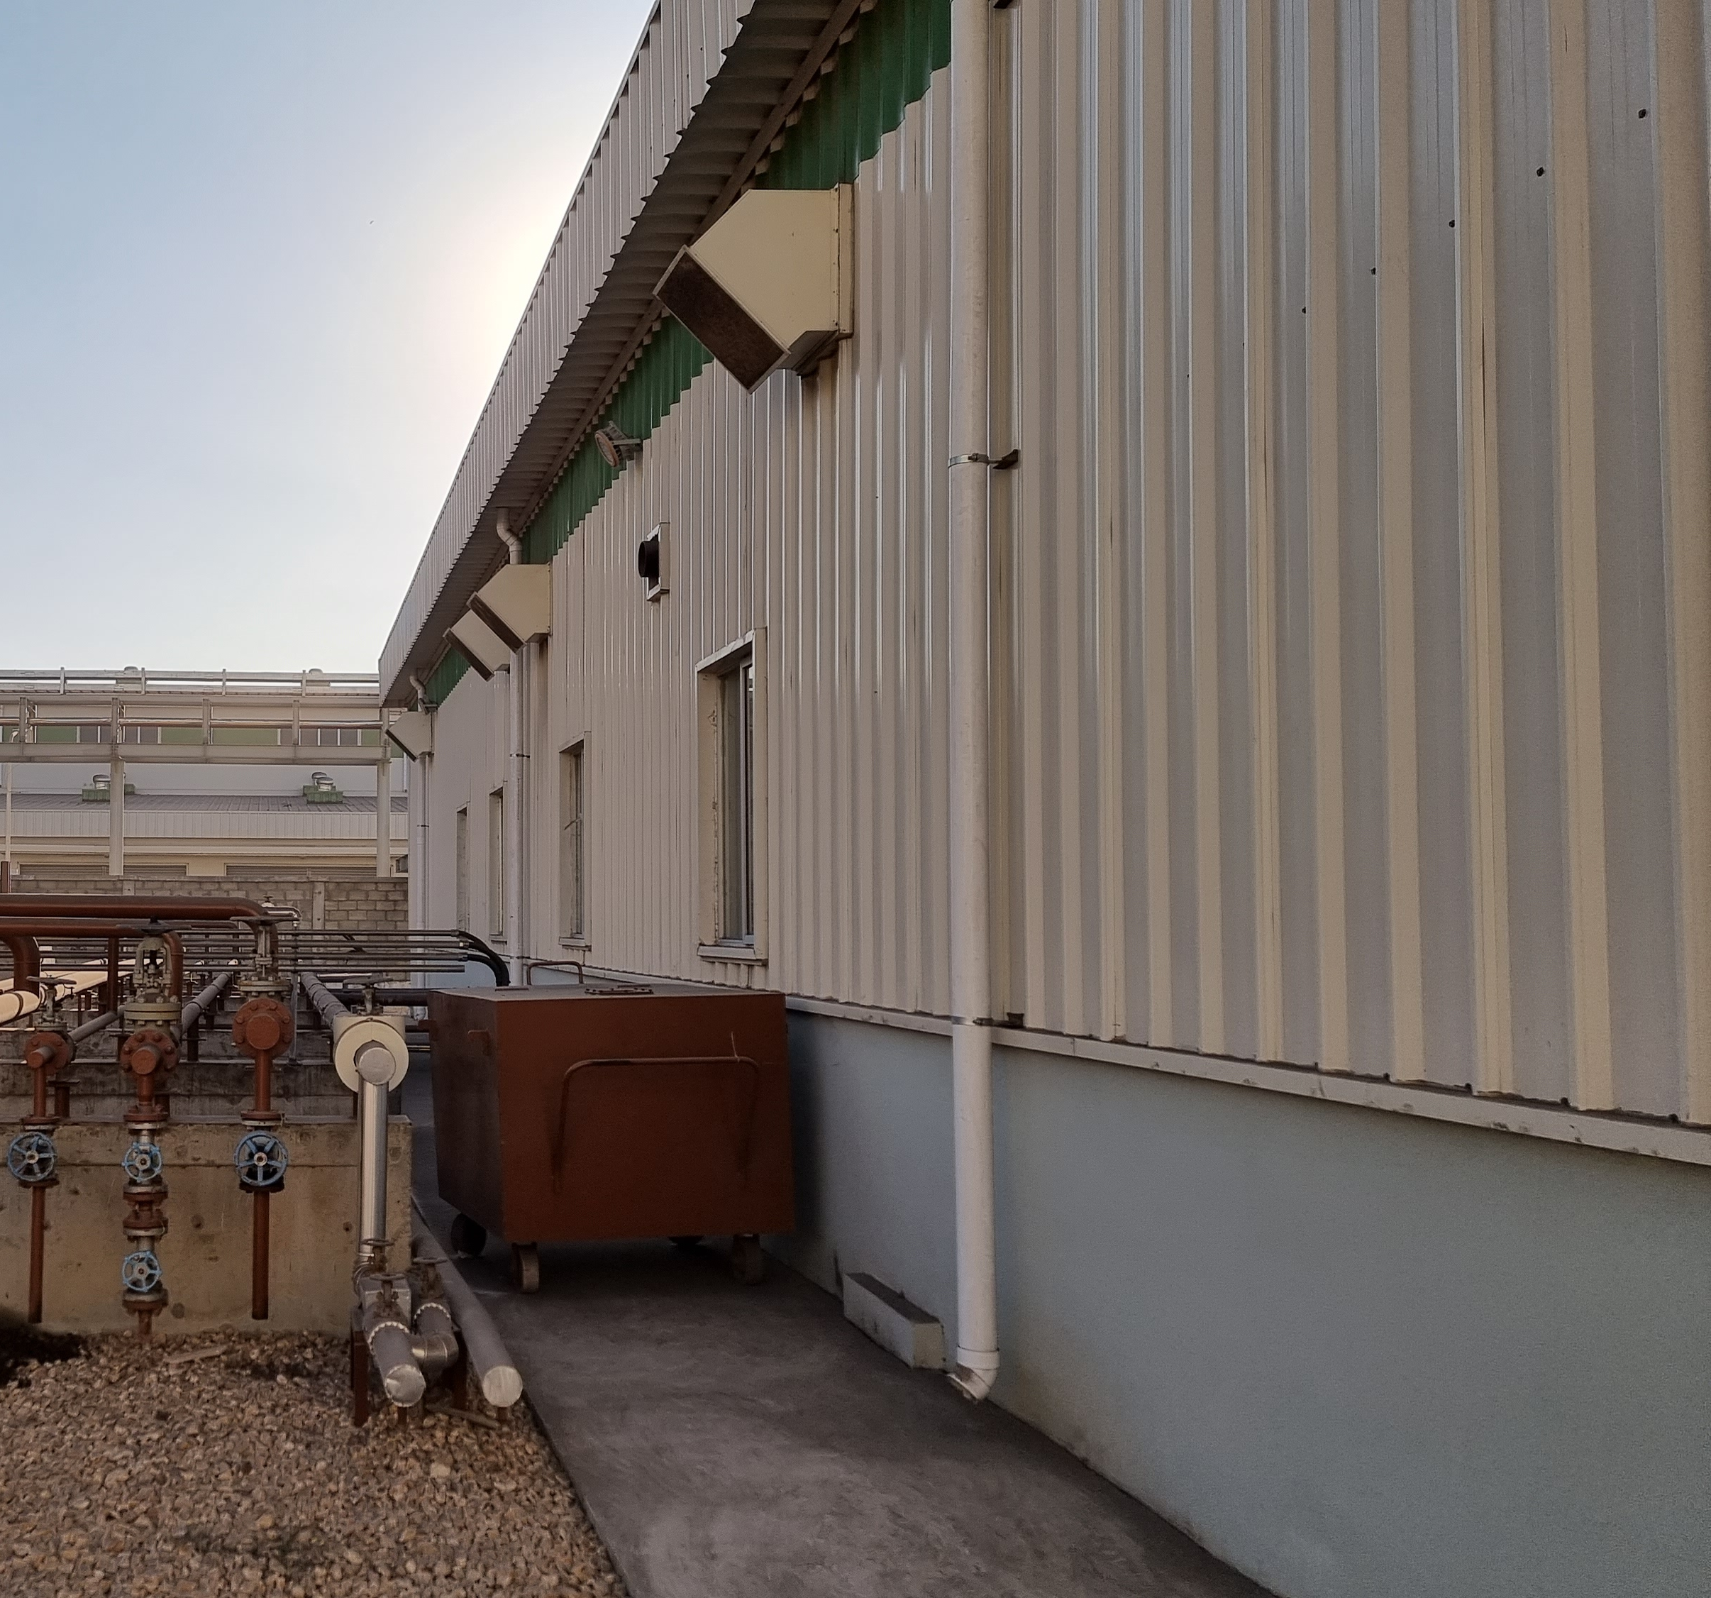
HAZOP vs HAC
Example: Fuel Handling (Indoors) with insufficient Ventilation

Slide 15
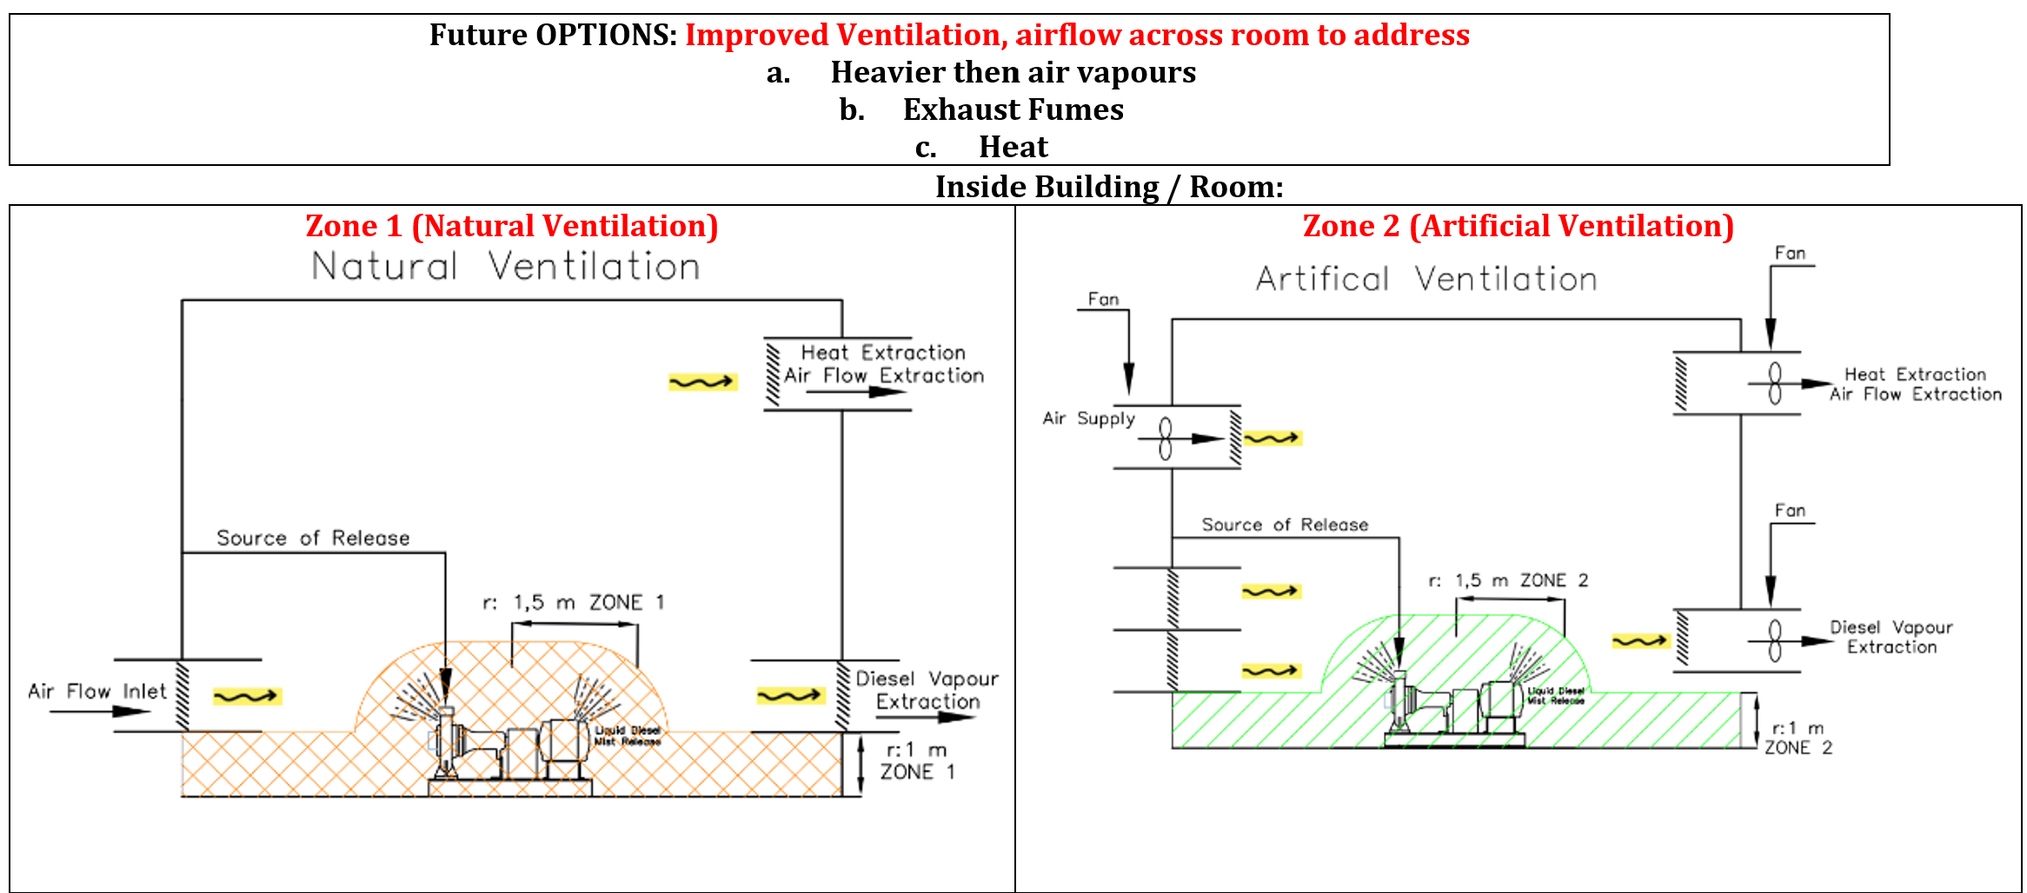
HAZOP vs HAC
Example: Fuel Handling (Indoors) with SUFFICIENT Ventilation

Slide 16
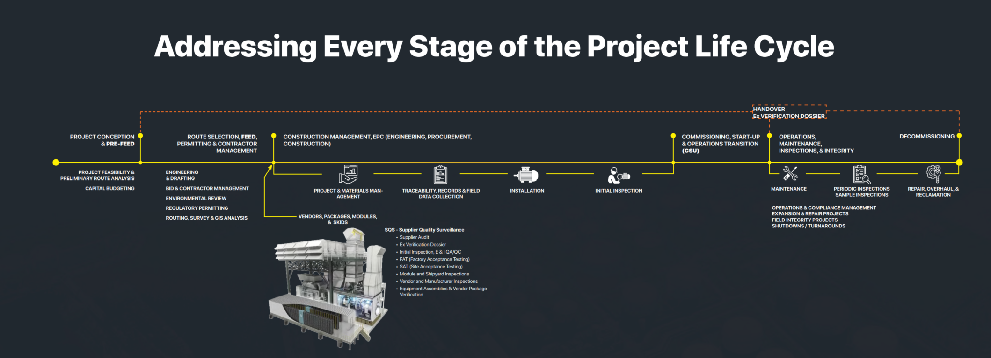
HAZOP vs HAC – Stages
HAZOP – New Facility or Process
HAZOP Review – Existing Facility
HAC + IHA – Initial (Simplified Method)
HAC – Yearly Review
HAC – Combintion Method
(Initial or Codes & Practices and/or Calculated + Vendor Packages)
HAZOP – Vendor Stage
HAC – Combintion Method
(Finalization for Handover)
HAC – Vendor Packages
MOC – Management of Change
Process or Operation Changes
Plant deterioration
Facility Incidents or External Lessons
MOC – Management of Change by whom?

Slide 17
HAC + IHA – The Standardized Method
Step 1: Go / No-Go Assessment
Assess all areas, even know not hazardous areas
Demonstrate full transparency

Slide 18
HAC + IHA – The Standardized Method
Step 2: Ignition Hazard Assessment
Assess all existing and potential 13 source of ignition
Demonstrate full transparency

Slide 19
HAC + IHA – The Standardized Method
Step 3: Area Description
Clearly define the process, and explain so at later reviews that all assumptions, decisions, references, and calculations can be understood
Demonstrate full transparency

Slide 20
HAC + IHA – The Standardized Method
Step 4: Flammable Materials
List all Flammable Materials, including from others (Vendors)
Show all sources of references
Demonstrate full transparency

Slide 21
HAC + IHA – The Standardized Method
Step 5: Sources of Release
List all sources of release, including from others (Vendors)
Show all sources of references
Demonstrate full transparency

Slide 22
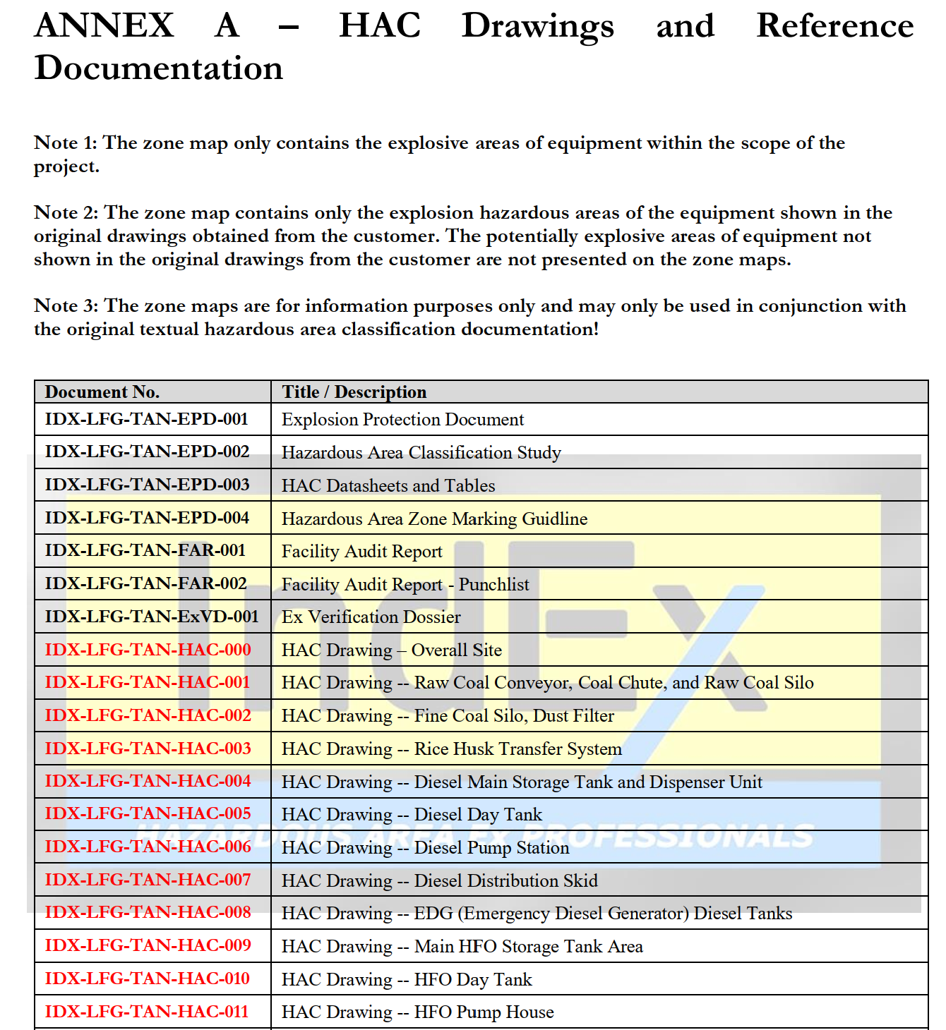
HAC + IHA –
The Standardized Method
Step 6: List all Documentation and Drawings
List all documents, drawings
Demonstrate full transparency

Slide 23
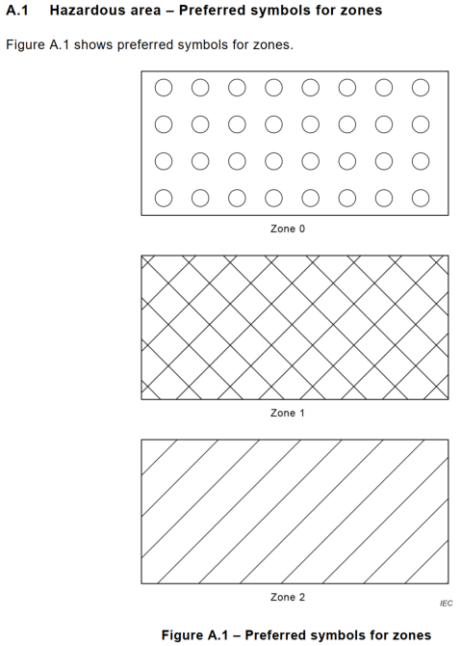
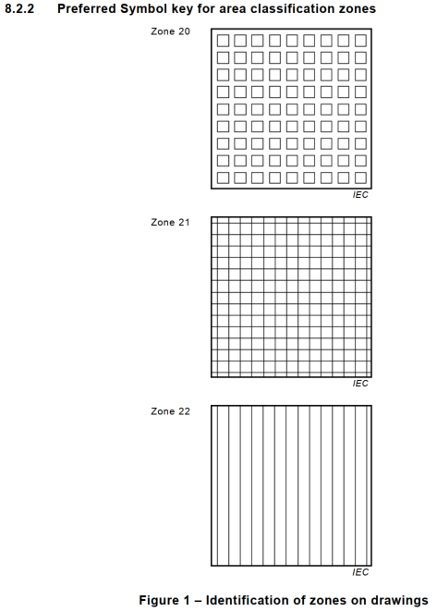
HAC + IHA –
The Standardized Method
Step 7: Define Symbols and Legends
Demonstrate full transparency
Gas, Vapours, Liquids | Dusts, Fibres, Flyings

Slide 24
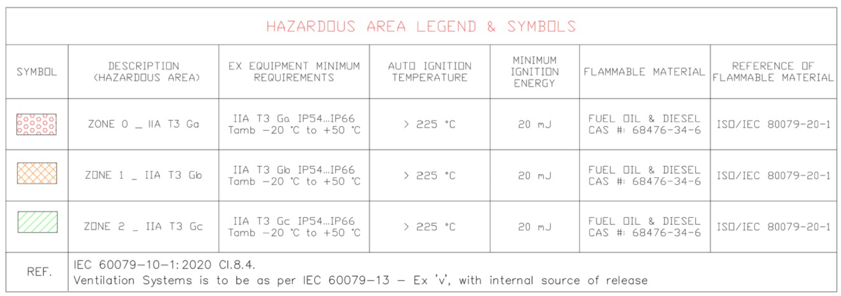
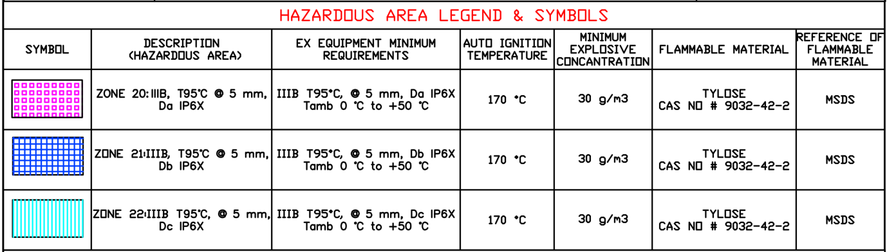
HAC + IHA –
The Standardized Method
Step 7: Define Symbols and Legends
Demonstrate full transparency
Gas, Vapours, Liquids
Dusts, Fibres, Flyings
Include AREA Requirements
  Zone
  Group
  Temperature Class
  Dust Layer Thickness (if applicable)
  EPL (Equipment Protection Level)
  Tamb (Ambient Temperature
  IP Rating (Minimum Ingress Protection)
Include Equipment Requirements
  Group
  Temperature Class
  Dust Layer Thickness (if applicable)
  EPL (Equipment Protection Level)
  Tamb (Ambient Temperature
  IP Rating (Minimum Ingress Protection)

Slide 25
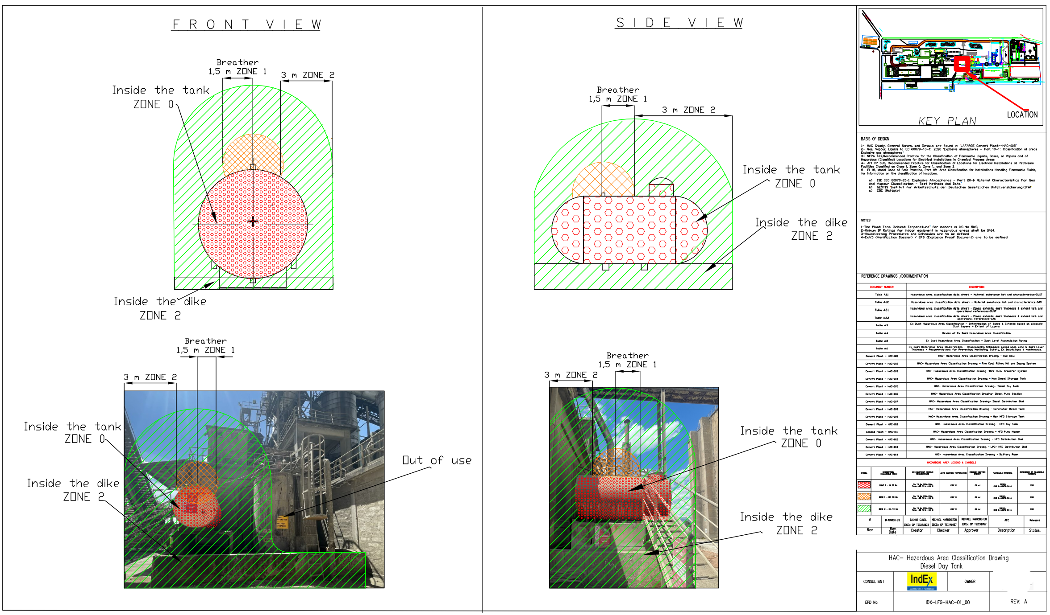
HAC + IHA –
The Standardized Method
Step 8: Define HAC Drawing Design
Demonstrate full transparency
Must be legible for in-field use in A3 format
Shall be used for Designers, Procurement, Installers, Inspectors, and Operators

Slide 26
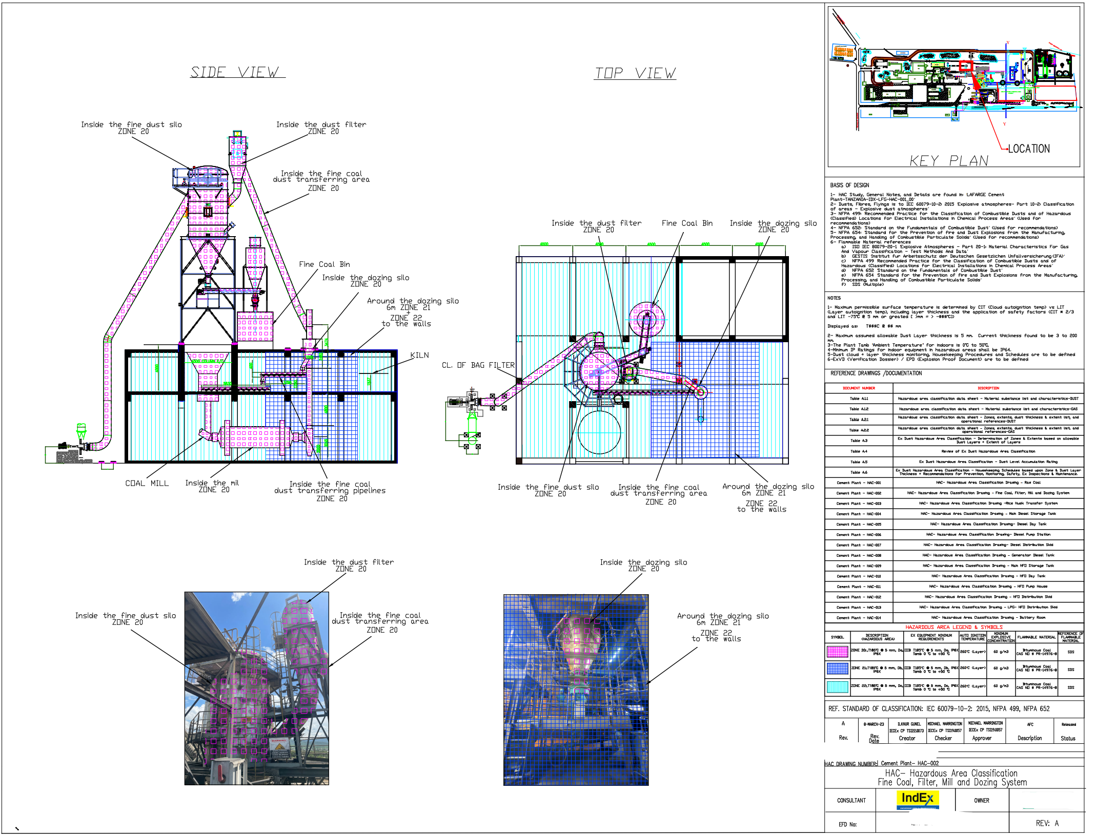
HAC + IHA –
The Standardized Method
Step 8: Define HAC Drawing Design
Demonstrate full transparency
Must be legible for in-field use in A3 format
Shall be used for Designers, Procurement, Installers, Inspectors, and Operators

Slide 27
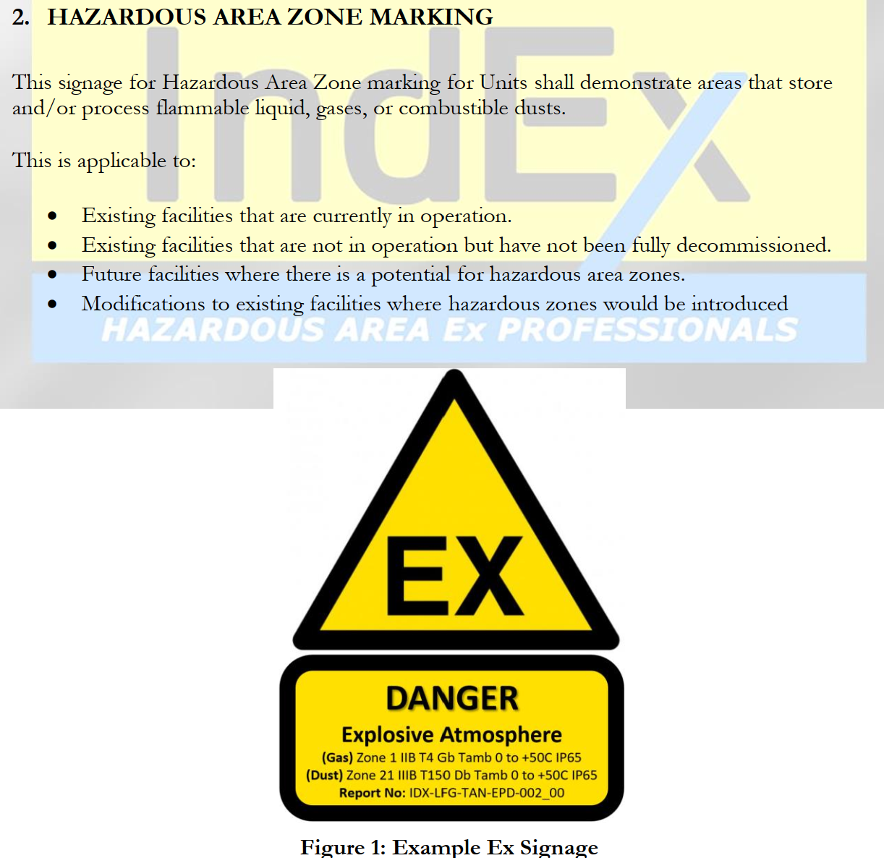
HAC + IHA –
The Standardized Method
Step 9: Define HAC Signage / Zone Marking
Demonstrate full transparency
Must be legible for in-field use in A3 format
Shall be used for Designers, Procurement, Installers, Inspectors, and Operators

Slide 28
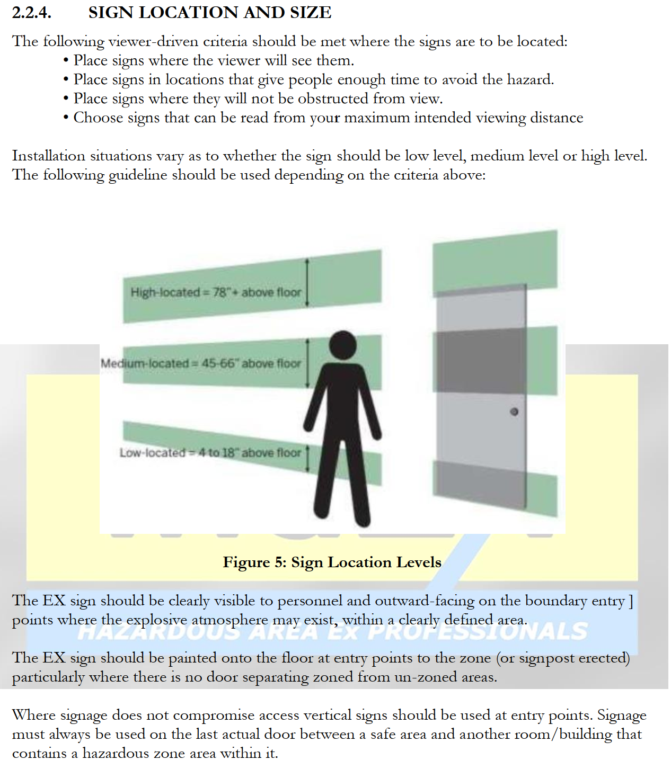
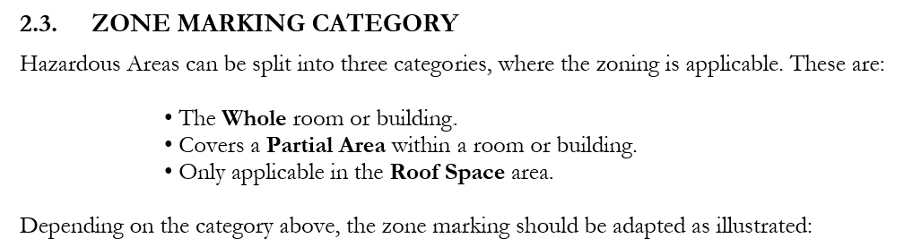
HAC + IHA –
The Standardized Method
Step 7: Define HAC Signage / Zone Marking
Demonstrate full transparency
Must be legible for in-field use in A3 format
Shall be used for Designers, Procurement, Installers, Inspectors, and Operators

Slide 29
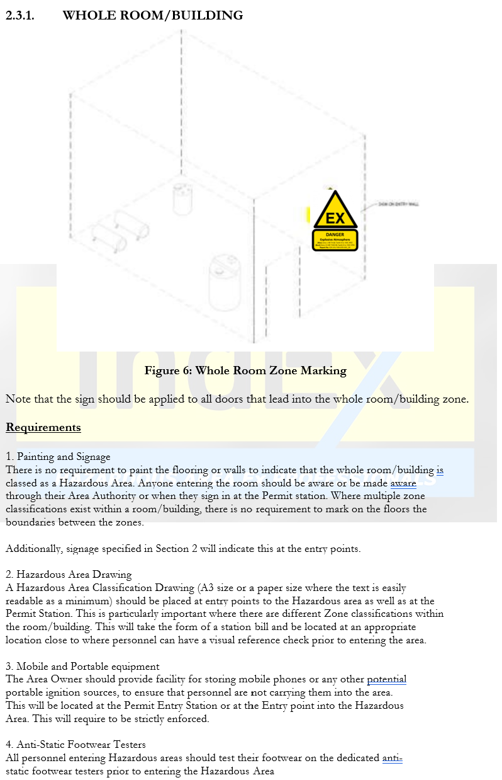
HAC + IHA –
The Standardized Method
Step 9: Define HAC Signage / Zone Marking
Demonstrate full transparency
Must be legible for in-field use in A3 format
Shall be used for Designers, Procurement, Installers, Inspectors, and Operators

Slide 30
HAC + IHA –
The Standardized Method
Step 9: Define HAC Signage / Zone Marking
Demonstrate full transparency
Must be legible for in-field use in A3 format
Shall be used for Designers, Procurement, Installers, Inspectors, and Operators

Slide 31
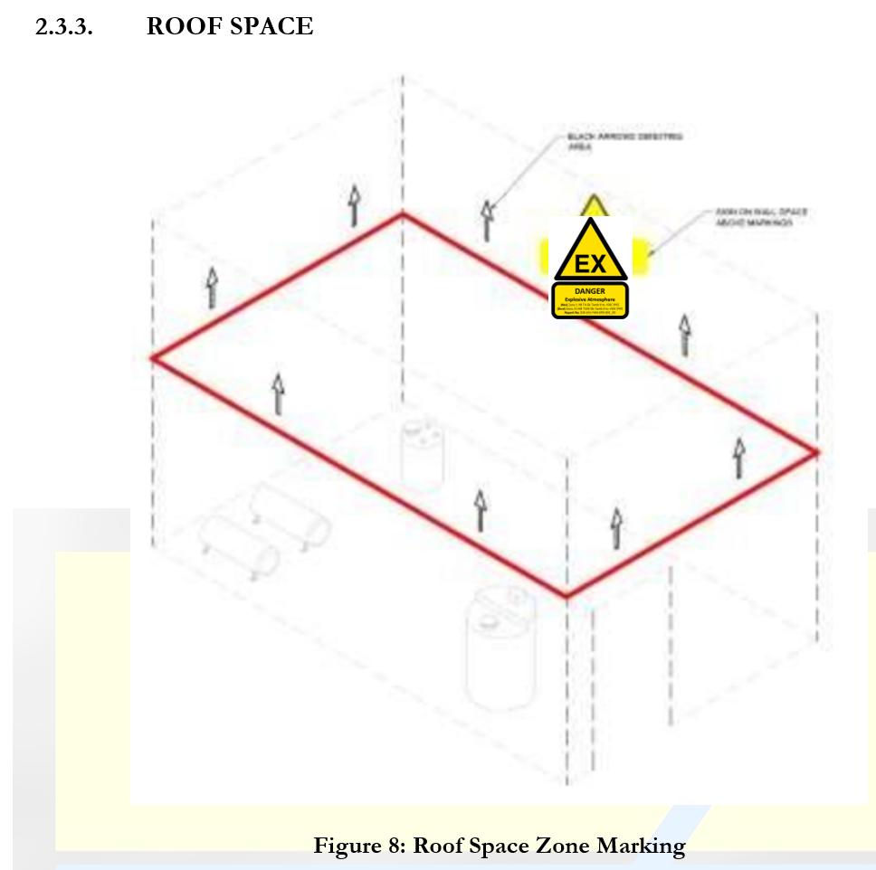
HAC + IHA –
The Standardized Method
Step 9: Define HAC Signage / Zone Marking
Demonstrate full transparency
Must be legible for in-field use in A3 format
Shall be used for Designers, Procurement, Installers, Inspectors, and Operators

